Slide 1
INDE LogRhythm Launch
11/08/2020

Slide 2


Agenda
Value proposition for a New Zealand SOC
  Scott Parker – Inde
Threat landscape in NZ and the Privacy Bill
  Alex Teh – CEO Chillisoft
The importance of Orchestration and Automation in a SOC
  Simon Howe – Vice President APAC LogRhythm
Customer’s experience with Inde SIEM and SOC
  Roger Temple from PGGW
  Nic Moody from NZ Health Group
Q&A and wrap-up
Drinks / Nibbles / Networking

Slide 3

Scott Parker Inde Security Architect
15 + Years Experience in the IT Industry
Focus - Providing practical advice to organisations looking for
security expertise and guidance
My passion - Is talking to people and businesses about practical security initiatives and technology, helping them remove any
industry ambiguity and focus on what’s important in their business
Outside of work - I’m a keen mountain biker always looking to
explore new trails!

Slide 4
Inde Security Team/SoC
What is the Value Proposition?
Notes:
The security landscape is changing – and rapidly.
With attackers searching for easy targets to infiltrate (and there are numerous), state sponsored attackers now making the news (Australia), and the proliferation of skiddies (script kiddies), the on-line, linked enterprise is fraught with risk.
Yet the Internet is indispensable...
Organizations cannot conduct business without connectivity, a Business without the Internet is not an option however both large and small organisations struggle to adequately secure their environment - again reference to the companies I mentioned earlier.
What does this show us?
IT shows that there is definitely a need for advanced detection tools, matching processes with highly skilled security resource to digest and deal with the growing number of security incidents and threats that are happening inside NZ businesses today that absolutely demand a response!

Slide 5
Can Your Organisation Answer the following Questions?
Do you have the visibility and tooling to detect system or credential compromise?
Do you know what compromise looks like and what indicators/evidence to look for to confirm/deny?
If compromise was detected, do you know what to do next /or how to remediate it?

Slide 6
Inde Security Team/SoC
The Inde Security team can assist you with answering those three simple questions!
We have experience with a proven track record of identifying compromise for our clients
Were a work with company, preferring to work alongside your team to implement and pro-actively manage security to meet requirements; this ensures effectiveness of controls plus also makes us flexible!
Transparency; we give you access to the same tools we use, well even show you how to use it if there is interest
Continual research / investigation into latest threat / exploits / breaches
(we break then down in team sessions to understand if the tooling and alerting we
have in place for our clients would have detected/ been effective)
Notes:
We will ask the questions, example In one of our client environments,
an Internal Inde resource was added to a privileged AD group (Domain Admins)
- our security analysts detected this within 3 minutes and questioned weather it was sanctioned or not.

Slide 7

State of Cyber-Sec in NZ & Privacy Bill 2020
Inde and LogRhythm launch
By Alex Teh - CEO

Slide 8


What is the current state of cybersecurity in NZ?
Cyber Threat Report:
NCSC report 108% increase in cyber attacks from 2015 to 2019
339 Nationally significant breaches last year
38% state sponsored attacks – Political motivation
(Russian – Political, Chinese – IP Theft)
Reported that since AU Mandatory disclosure – 712% incident report growth
NZ Privacy Bill – Will be law from Dec 2020

Slide 9

Current state of cybersecurity
Incident reports increased by 205% since 2018
Financial loss of $14.1M – over $8M of which was due to scam and fraud reports
Attacks on the private sector went up from 20% to 37%
Top incident categories:
      1,550 phishing attacks per year
      400+ scam and fraud per Q
      400+ compromised credential theft per Q

Slide 10
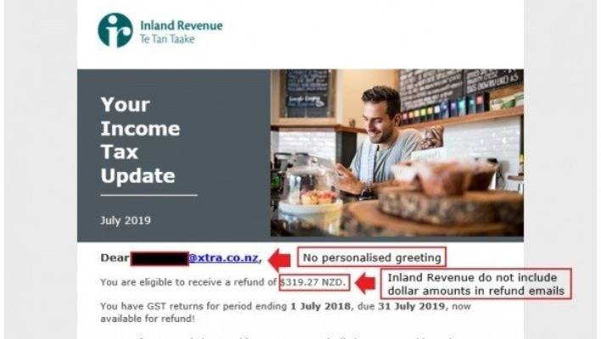
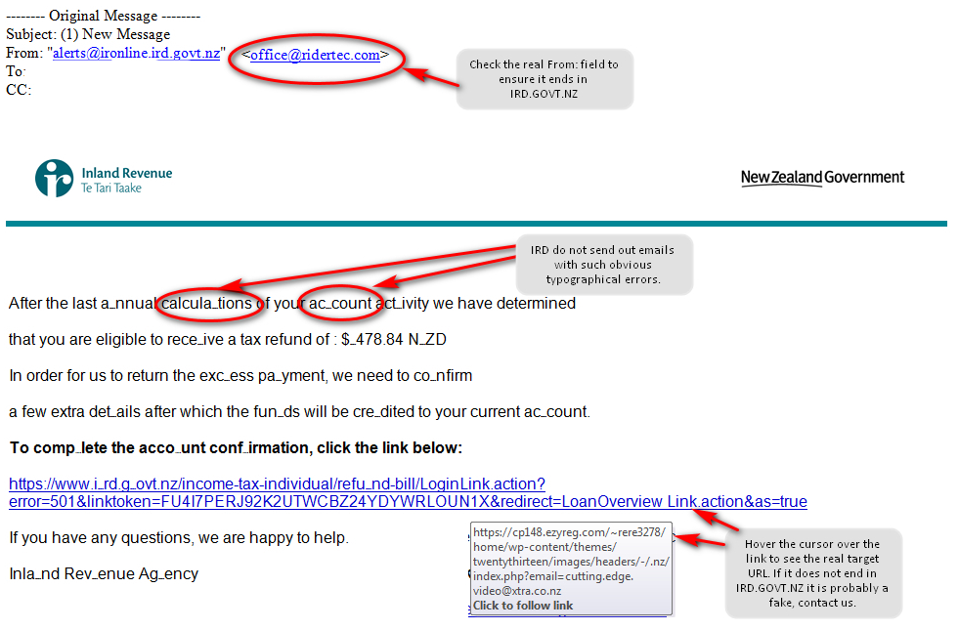
Phishing Scams – IRD (Credential Theft)
Notes:
22 July 2019, NZ Herald reported – IRD is warming consumers of an elabortate email scam claiming to be from the tax department.
IRD says a new "convincing" email scam which seeks to take advantage of those waiting on a tax refund is doing the rounds claiming to be from Inland Revenue.
In the email which is titled: "Your income tax update", the fraudulent email addresses the consumer directly and states a dollar figure amount 'refund’.
The email says IRD tried to send the refund to you automatically but were "unable to do so as we don't have your details on file". It asks if you are "ready to refund it now".
IRD says this should raise alarm bells as the tax department does not include personalised greetings in its emails and does not include dollar amount in refund emails.
Inland Revenue spokeswoman Sharon Thompson said the scam appeared to be widespread, with more than 900 reports of the email over the weekend.
"It looks like the real thing but has some tell-tale mistakes that people can use to tell it's a scam," Thompson said.
"Embedded links can look quite convincing at first glance as "ird.govt.nz" can be included within the address. But if you hover over those links, you'll see Inland Revenue is not the destination."
Inland Revenue is in the process of having the scam removed but the sites with direct links prompting consumers to can "jump back up again", IRD said.

Slide 11
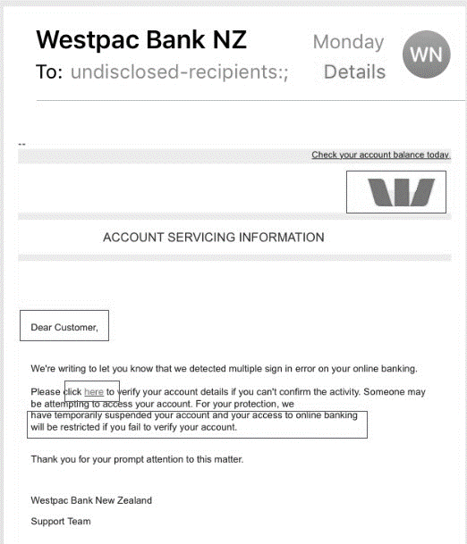
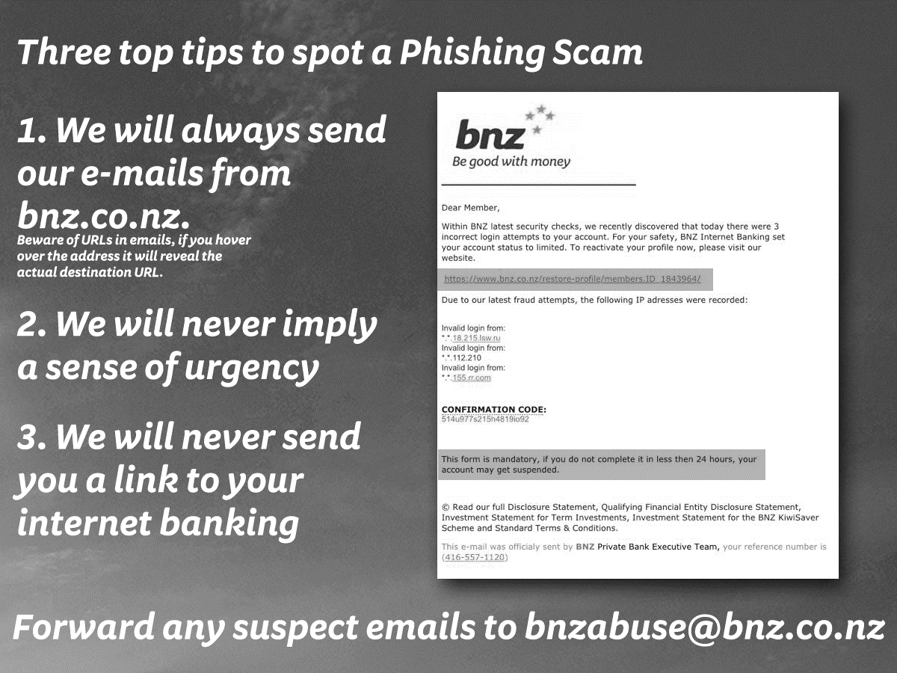
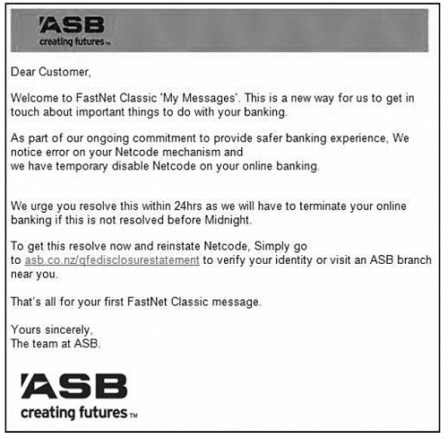
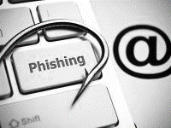
Banking Phishing Scams in Pacific
Notes:
Really, what it comes down to is it's intentionally deceiving someone by posing as someone else. Traditionally, they use a legitimate company. Typically, they also utilize email by pretending to be a company or service, requesting you to do something, and usually requesting you to do something in an urgent matter. They're hoping that you then click the link and fill out the requested information. Then, they gain that information that they can use in the future, steal your identity, or steal access to any of your accounts.

Slide 12
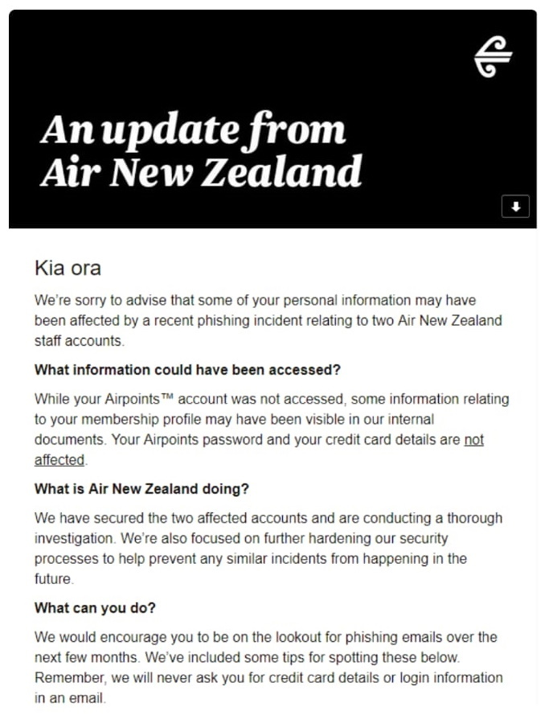
Phishing Attack Air New Zealand
No email security vendor is bullet proof!
Couple email security with Security awareness training
Simulate phishing attacked on your staff
Measure the success of your program
Notes:
9 August – AirNZ sent e-mails to customers enrolled in its Airpoints loyalty program​​​​​​ to warn them of a phishing attack that successfully compromised the email accounts of two staff members which potentially led to personal information being accessed by the attackers.

Slide 13
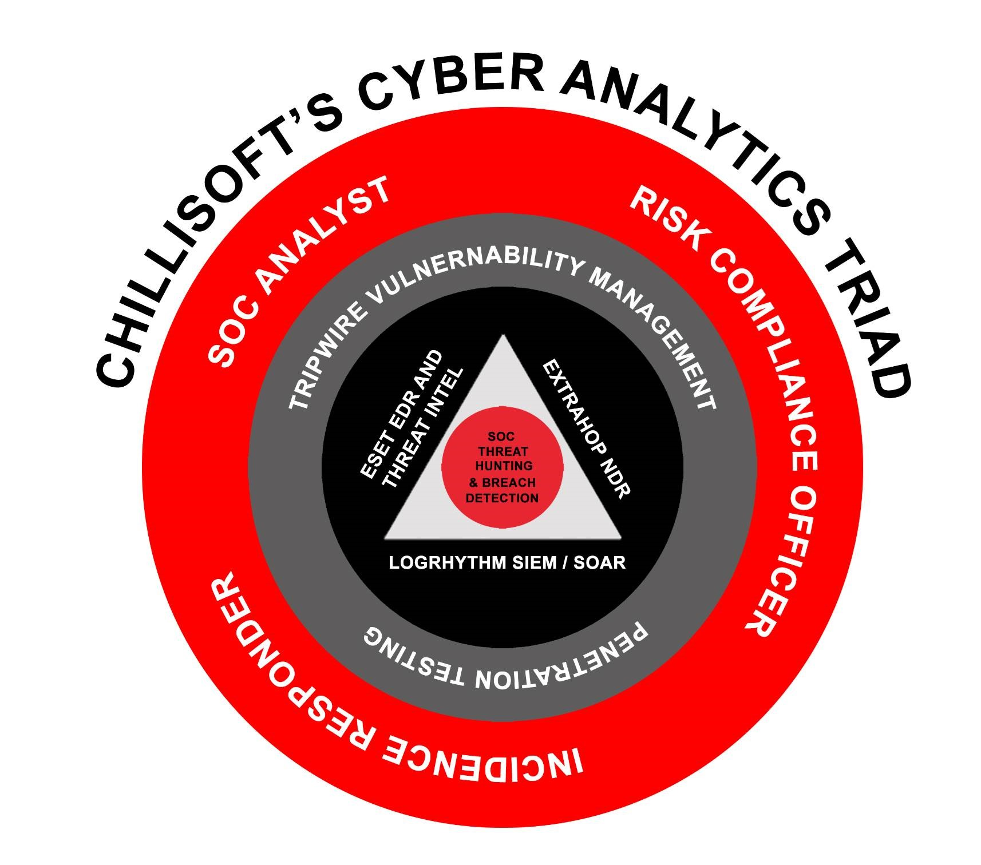

Current state of cybersecurity in the Pacific
APAC accounts for 35.9% of global cybersecurity events
  APAC organizations take 1.7 times longer than the
  global average to detect a breach.
  70% of enterprises in APAC lack a solid understanding of their cyber posture.
  Median dwell time for externally notified breaches was 417 days in 2017 and 1,088 days now
The Cyber Analytics Triad – SIEM, NDR & EDR
Notes:
PACSON – established 30 April 2018 as a network of government-designated cybersecurity incident response officials from across thw Pacific: Australia, NZ, Cook Islands, Fiji, Kiribati, Marshall Islands, Niue, Palau, Papa New Guinea, Samoa, Solomon Islands, Tokelau, Tonga, Tuvalu, and Vanuatu – chaired by CertNZ
APAC stats - latest findings of the 2018 First Half Review of the Breach Level Index, released October 2018 by Gemalto
*Fireye (source)

Slide 14
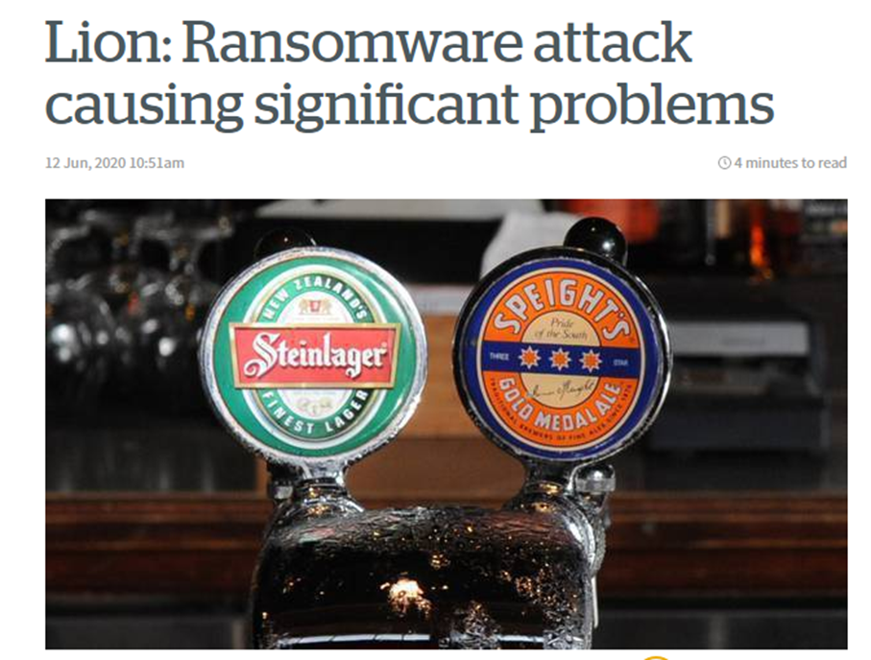
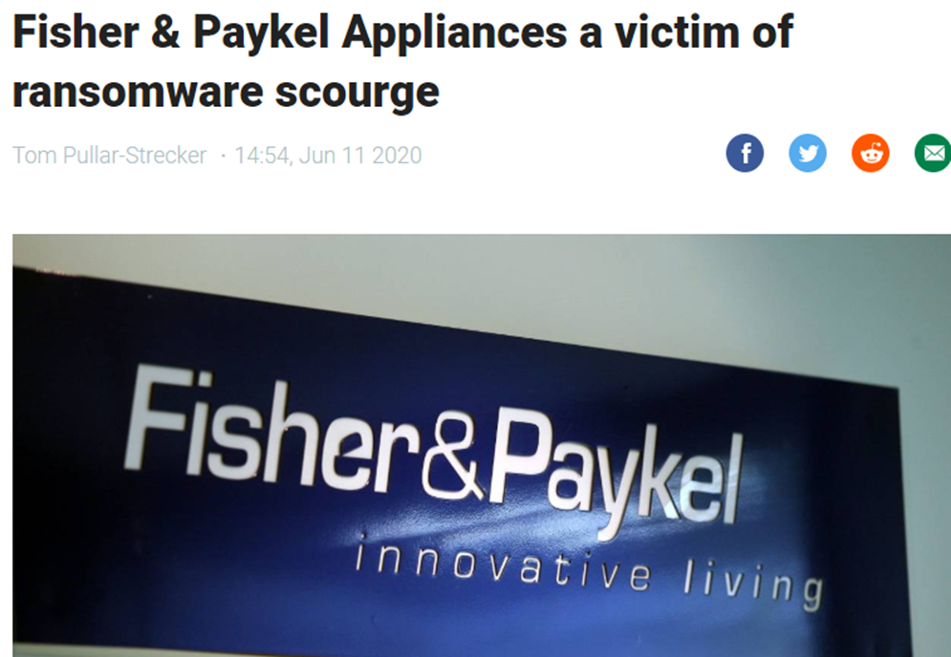
NZ threat landscape
Organizations going from 10% working from home to 100% due to Covid19. Higher % working from home after lockdown.
Multi layer attacks that includes:
- Covid19 phishing attacks (38% increase)
- Compromised home users without 2FA
- Compromised VPN and RPD using brute force attacks
- Compromised network and domain admin
- Disabled, encrypted and data loss of back ups
Double ransomware ($1.25 for the decryption and same again for not selling their data)

Slide 15






A Threat Engine to Smart Cities
– Serious Organised Crime (SOC)
953 Breaches in 2010
Crime as a Service
Cryptoware
Malware and I.D. Theft
Payment Card/Order Fraud
Network Attack
Notes:
Key Talking Points:
Victims of damaging cyber breaches make the news every week – don’t become one of them!
These are just a sampling of breaches– even more are occurring
The rate of breaches continues to go up every year
Not just experienced by large companies
Affects companies of all sizes and industries
Notes:
Bad actors have executed a series of high-profile, damaging data breaches. It seems like there’s someone new on the cover of the WSJ every week. This slide illustrates how much damage is being done.
This graphic represents the number of records exposed (bigger circles were breaches with more exposed records)

Slide 16
Transnational Organised Crime
01
Migrant Smuggling - $15 Billion
02
Human Trafficking - $70 Billion
Transnational Organised
Crime is estimated at $1,700,000,000
03
Arms Trade - $150 Billion
04
Drug Trade - $400 Billion
05
Cyber Crime - $490 Billion
06
Counterfeiting - $560 Billion
Notes:
LogRhythm is the platform for Big Data Security Analytics.
LogRhythm develops set of winning solutions that provides the visibility needed to secure and fortify your digital infrastructure…
Automate and assure regulatory compliance. PCI-DSS, ISO, or HiPPA. Ex. Agro Bank
Detect and Respond to advanced threats and breaches. Ex. Nepal Investment Bank
Deliver early identification and fast response to IT incidents or operations issues
LogRhythm is the largest and fastest growing independent SIEM provider in the world with global operations and over 3000 customers spanning six continents.
LogRhythm only leader that began with vision for security intelligence and has developed towards this goal.
LogRhythm is the only Gartner SIEM Leader with a company-wide, singular focus on Security Intelligence
Founders, CTO and Chief Scientist, still with company
100% R&D to Security Intelligence
And its our perpetual commitment to customer success that has led to a customer retention rate of over 95%. Most other SIEM providers are massive companies for which SIEM is a tiny fraction of their overall business, which is reflected in their level of SIEM innovation and support expertise.
But at the end of the day, it’s all about the value we’re delivering to our customers. And we’re helping more and more organizations every day, secure their enterprises, comply with regulations, and improve the improve the effectiveness of their IT operations.

Slide 17
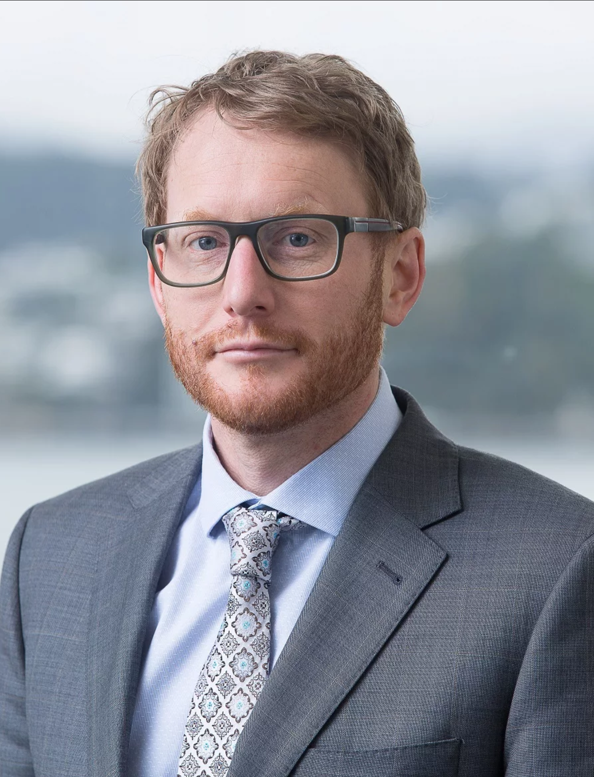
Jon Duffy
NZ’s Privacy Bill
The prognosis for March 2020
Assistant Privacy Commissioner
Policy and Operations

Slide 18
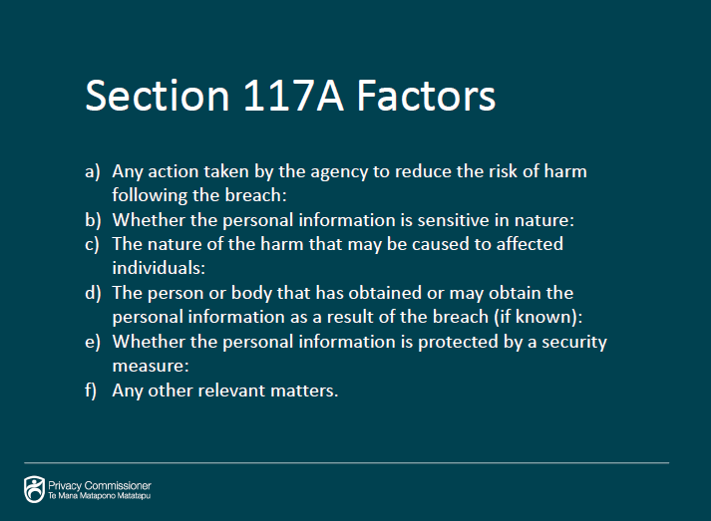
New Zealand Privacy Bill
Due to be law in Dec 2020
NZ’s version of GDPR
Must be able to report breach within 72 hours
Must allow public to query what PII information
Must allow public to request removal of unnecessary PII information
Have you seen this this site? (www.ico.org.uk)
Notes:
Scam and fraud incidents decreased in quarter one, to 33% of all reports received – down from 50% in quarter four 2018. Despite the decline in reports, financial losses experienced as a result of scams and fraud made up 80% of the total in quarter one.
Top three types of scam and fraud incidents in quarter one were:
- 53% email extortion scams
- 24% scams related to buying and selling goods online
- 6% invoice scams
CERT NZ expects to see these types of scams evolve, with new variants being introduced as people become aware of scammers tactics.

Slide 19
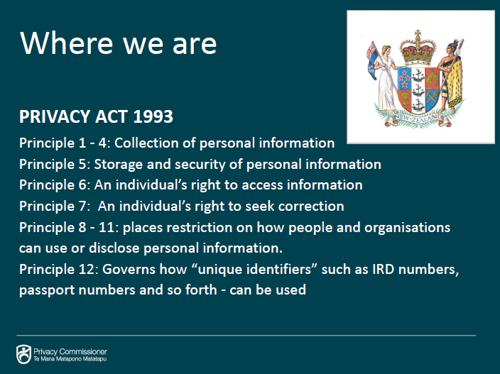
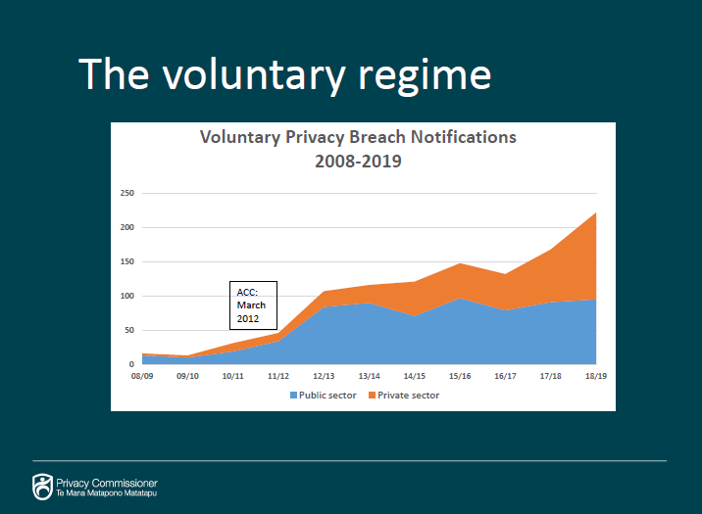
New Zealand Privacy Bill
- Current law – 25 year old!
Current voluntary breach notification steadily increasing
Many incidence are still swept under the carpet
Notes:
Scam and fraud incidents decreased in quarter one, to 33% of all reports received – down from 50% in quarter four 2018. Despite the decline in reports, financial losses experienced as a result of scams and fraud made up 80% of the total in quarter one.
Top three types of scam and fraud incidents in quarter one were:
- 53% email extortion scams
- 24% scams related to buying and selling goods online
- 6% invoice scams
CERT NZ expects to see these types of scams evolve, with new variants being introduced as people become aware of scammers tactics.

Slide 20
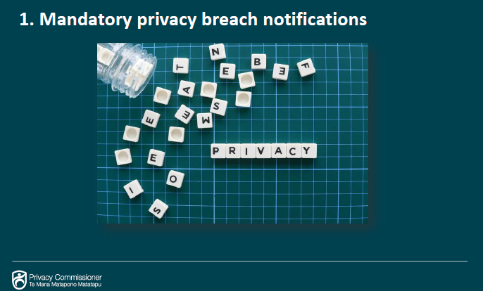
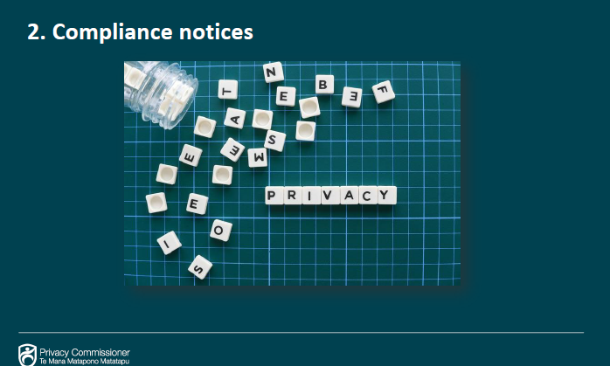
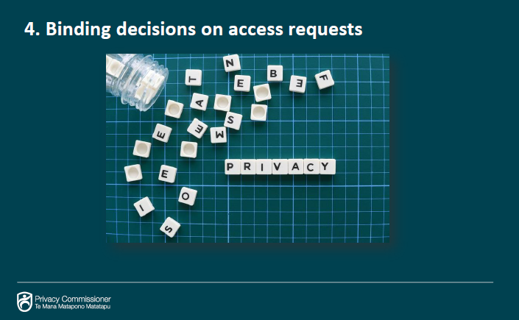
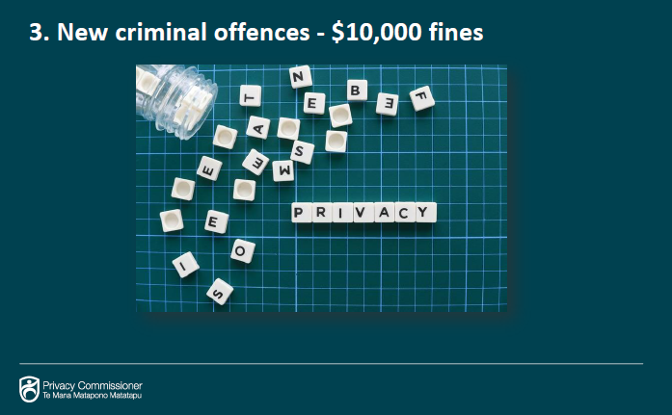
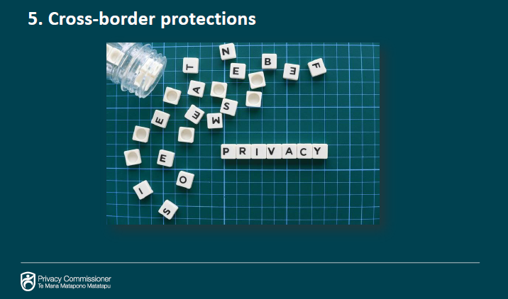
New Zealand Privacy Bill
1. Mandatory Breach Notification
2. Power to issue notification
Fines – low but open for interpretation (reputation loss)
Data discovery is important for access request
Cross border protection – (Google /.Facebook)
Notes:
Scam and fraud incidents decreased in quarter one, to 33% of all reports received – down from 50% in quarter four 2018. Despite the decline in reports, financial losses experienced as a result of scams and fraud made up 80% of the total in quarter one.
Top three types of scam and fraud incidents in quarter one were:
- 53% email extortion scams
- 24% scams related to buying and selling goods online
- 6% invoice scams
CERT NZ expects to see these types of scams evolve, with new variants being introduced as people become aware of scammers tactics.

Slide 21
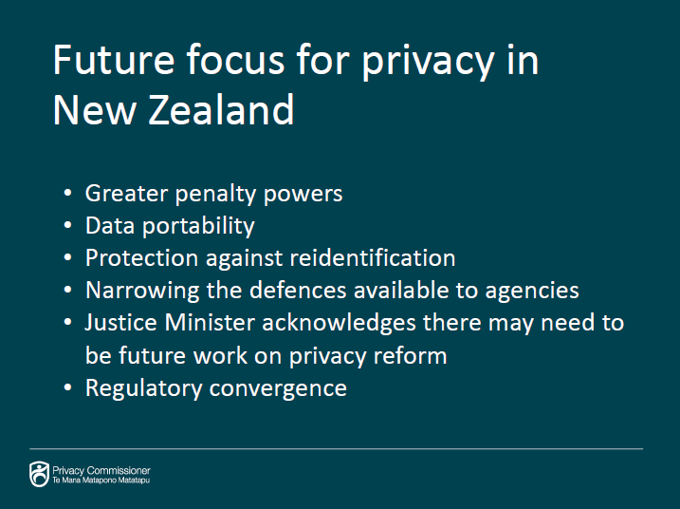
New Zealand Privacy Bill
- Most Kiwis support this Bill
-Its there to protect us as citizens
But what about the future of this law?
What’s happening overseas?
Notes:
Scam and fraud incidents decreased in quarter one, to 33% of all reports received – down from 50% in quarter four 2018. Despite the decline in reports, financial losses experienced as a result of scams and fraud made up 80% of the total in quarter one.
Top three types of scam and fraud incidents in quarter one were:
- 53% email extortion scams
- 24% scams related to buying and selling goods online
- 6% invoice scams
CERT NZ expects to see these types of scams evolve, with new variants being introduced as people become aware of scammers tactics.

Slide 22

Tony Anscombe
  Chief Security Evangelist
  tony.anscombe@eset.com

Slide 23

‘Reasonable’

Slide 24
Minimum requirements for “defensible defense”
A designated person in charge of security, also privacy
Understand where the data is
Only collect data with a purpose
Delete data no longer required
Educate the business on the need for compliance
Train staff involved in data processing
Control access to data
Audits
Monitor and record keep
Interface to consumers
Notes:
Firstly – know your data an where it is
There is no guaranteed checklist
What you want is defensible defense, so at least:
Put someone in charge of data and compliance
GDPR requires a DPO, CCPA should!
The mandate this person has should be from the CEO
The highest level of the company MUST support compliance
There is no guaranteed checklist
What you want is defensible defense, so at least:
Educating on compliance
Training staff involved in processing
Audits, contact point, monitoring
Record keeper
Interface to consumers

Slide 25
Minimum requirements for “defensible defense”
Documentation of your relatively recent risk assessment
A coherent set of security policies
Adequate controls to enforce them
Evidence of ongoing maintenance
Pen testing and crisis management
Notes:
There is no guaranteed checklist
What you want is defensible defense, so at least:
Educating on compliance
Training staff involved in processing
Audits, contact point, monitoring
Record keeper
Interface to consumers
A coherent set of security policies Adequate controls to enforce them
Evidence of ongoing maintenance
Pen testing and crisis management

Slide 26

Reasonable security
Locking the front door doesn’t offer much protection if the back door is left open.
User authentication and access controls
Multifactor authentication
Encrypt/hash stored passwords

Slide 27



Reasonable security
Encryption
At rest
In transit

Slide 28
Reasonable security
Segmentation
Firewalls
Secure by design
Internal products
External products
Address vulnerabilities
‘A security chap telling us we need to update!’

Slide 29
Reasonable security
Endpoint protection (on all endpoints)
Backup and recovery systems
Documented employee security awareness training
Secure paper, physical media and devices
Notes:
And don’t forget the physical!
Paper
Invoices
Laptops
Media

Slide 30
Action plan
Understand the timelines and key milestones
Assessment of the risk to my business
Action plan for compliance
Understanding of “reasonable security”
Roadmap to demonstrating reasonable security
1
2
3
4
5

Slide 31

“As cybersecurity leaders, we have to create our message of influence because security is a culture, and you need the business to take place and be part of that security culture.”
— Britney Hommertzheim

